Slide 1

Sistemas para la indústria Alimentícia
July – 2019
Victor Barbieri – Systems

Slide 2
Tópicos Cubiertos
Conjetura de la Industria
Producción
  Calidad
  Salud
  Confianza
  Versatilidad
  Reducción de desperdicios
  Mantenimiento
Aplicaciones
Notes:
END-TO-END PRODUCT INTEGRITY
Today's high quality foodstuffs are made with highly expensive ingredients. And the market trend is towards more recognisable processed foods with whole vegetables and fruits. Our systems enable you to handle - transfer, dose, mix and fill - challenging ingredients with minimal damage.
PERFORMANCE YOU CAN COUNT ON
Reliability and productivity are your best allies in facing the non-stop nature of today's just-in-time retail supply chain. PCM pumping, dosing, mixing and filling systems enable you to produce the same recipe identically from the start of your production run until the finish and ensure repeatability.
LOW LIFE CYCLE COSTS
A pump that is not well adapted to its operational parameters can cost you money in terms of production, maintenance downtime and energy consumption. We use Life Cycle Costs (LCC) analysis to find the most cost-effective pumping solutions for your industrial processes.
MEETING THE STRICTEST STANDARDS
We share your commitment to ensuring customer safety. To begin with, all our systems are CIP (Cleanable In Place). In addition, we continually invest in innovations that enable you to anticipate constantly evolving food safety regulations. Finally, our vast international experience enables us to design systems that meet both local regulations and international standards.

Slide 3
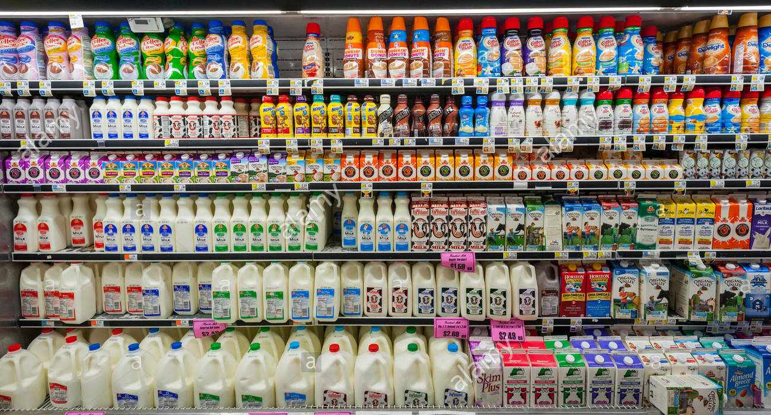
Conjetura de la indústria
Notes:
END-TO-END PRODUCT INTEGRITY
Today's high quality foodstuffs are made with highly expensive ingredients. And the market trend is towards more recognisable processed foods with whole vegetables and fruits. Our systems enable you to handle - transfer, dose, mix and fill - challenging ingredients with minimal damage.
PERFORMANCE YOU CAN COUNT ON
Reliability and productivity are your best allies in facing the non-stop nature of today's just-in-time retail supply chain. PCM pumping, dosing, mixing and filling systems enable you to produce the same recipe identically from the start of your production run until the finish and ensure repeatability.
LOW LIFE CYCLE COSTS
A pump that is not well adapted to its operational parameters can cost you money in terms of production, maintenance downtime and energy consumption. We use Life Cycle Costs (LCC) analysis to find the most cost-effective pumping solutions for your industrial processes.
MEETING THE STRICTEST STANDARDS
We share your commitment to ensuring customer safety. To begin with, all our systems are CIP (Cleanable In Place). In addition, we continually invest in innovations that enable you to anticipate constantly evolving food safety regulations. Finally, our vast international experience enables us to design systems that meet both local regulations and international standards.

Slide 4
Conjectura de la industria
Cambio constante en la demanda.
  Probioticos
  Kefir
Cambio constante en el suministro de materiales en bruto.
Cambio constante en las regulaciones (Locales y Globales).
Cambio constante en los tamaños del mercado.
  Plant Based Meat
  Fermeted Milk
Cambio constante en la disponibilidad de la fuerza laboral.
Cambio constante en las tendencias de salud.
Cambios constantes en la geopolítica.
  Mercosur x EU?
Cambio constante en el embalaje
  Paper or Plastic?
  Cambios constantes en la planta de manufactura
  IOT + Big Data + Industria 4.0
Notes:
END-TO-END PRODUCT INTEGRITY
Today's high quality foodstuffs are made with highly expensive ingredients. And the market trend is towards more recognisable processed foods with whole vegetables and fruits. Our systems enable you to handle - transfer, dose, mix and fill - challenging ingredients with minimal damage.
PERFORMANCE YOU CAN COUNT ON
Reliability and productivity are your best allies in facing the non-stop nature of today's just-in-time retail supply chain. PCM pumping, dosing, mixing and filling systems enable you to produce the same recipe identically from the start of your production run until the finish and ensure repeatability.
LOW LIFE CYCLE COSTS
A pump that is not well adapted to its operational parameters can cost you money in terms of production, maintenance downtime and energy consumption. We use Life Cycle Costs (LCC) analysis to find the most cost-effective pumping solutions for your industrial processes.
MEETING THE STRICTEST STANDARDS
We share your commitment to ensuring customer safety. To begin with, all our systems are CIP (Cleanable In Place). In addition, we continually invest in innovations that enable you to anticipate constantly evolving food safety regulations. Finally, our vast international experience enables us to design systems that meet both local regulations and international standards.

Slide 5
Conjetura de la industria – Latinoamericana
Producción
  Calidad
  Salud
  Confianza
  Versatilidad
  Reducción de desperdicios
  Mantenimiento
Aplicaciones
Notes:
END-TO-END PRODUCT INTEGRITY
Today's high quality foodstuffs are made with highly expensive ingredients. And the market trend is towards more recognisable processed foods with whole vegetables and fruits. Our systems enable you to handle - transfer, dose, mix and fill - challenging ingredients with minimal damage.
PERFORMANCE YOU CAN COUNT ON
Reliability and productivity are your best allies in facing the non-stop nature of today's just-in-time retail supply chain. PCM pumping, dosing, mixing and filling systems enable you to produce the same recipe identically from the start of your production run until the finish and ensure repeatability.
LOW LIFE CYCLE COSTS
A pump that is not well adapted to its operational parameters can cost you money in terms of production, maintenance downtime and energy consumption. We use Life Cycle Costs (LCC) analysis to find the most cost-effective pumping solutions for your industrial processes.
MEETING THE STRICTEST STANDARDS
We share your commitment to ensuring customer safety. To begin with, all our systems are CIP (Cleanable In Place). In addition, we continually invest in innovations that enable you to anticipate constantly evolving food safety regulations. Finally, our vast international experience enables us to design systems that meet both local regulations and international standards.

Slide 6
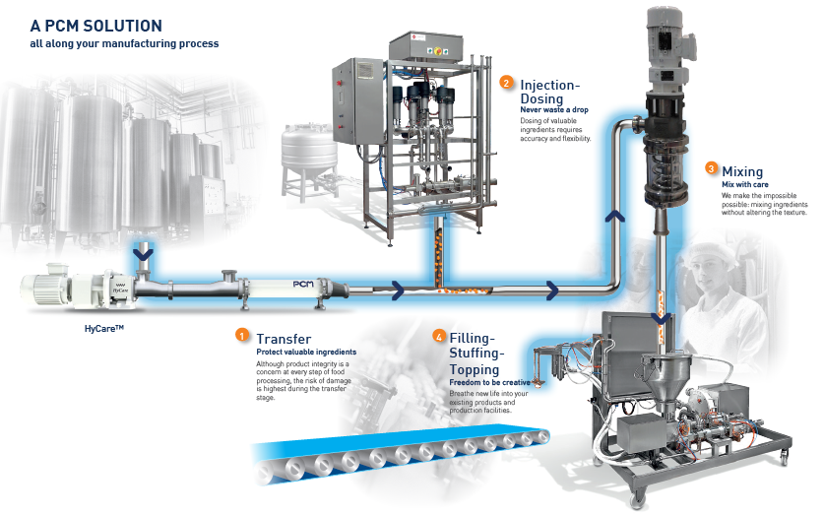
Una SOLUCIÓN PCM a lo largo de su proceso de fabricación.

Slide 7











REGULACIONES Y PRACTICAS INTERNACIONALES
Machinery directive 2006/42/CE
Hygiene directive CE/93/43
Materials for food stuff CE n°1935/2004
Leyes / Regulaciones
CEN 1672-2
NF EN 13951
ISO 14 159
Normas / Guías

Slide 8
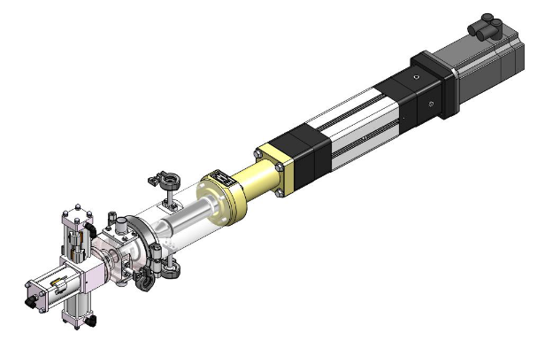
PCM DOSYS™ Bombas de Piston controladas
Las claves para la perfección en llenado y dosificación
PRINCIPIO
Notes:
Dosys™ pump automatically synchronises dosing volumes with the filling station for optimal performance. It also meters the ingredients with precision, thanks to servo-driven piston and a patented flow-control valve. Dosys™ pumps are designed to handle liquids, semi-solids and viscous products without degrading their texture.

Slide 9
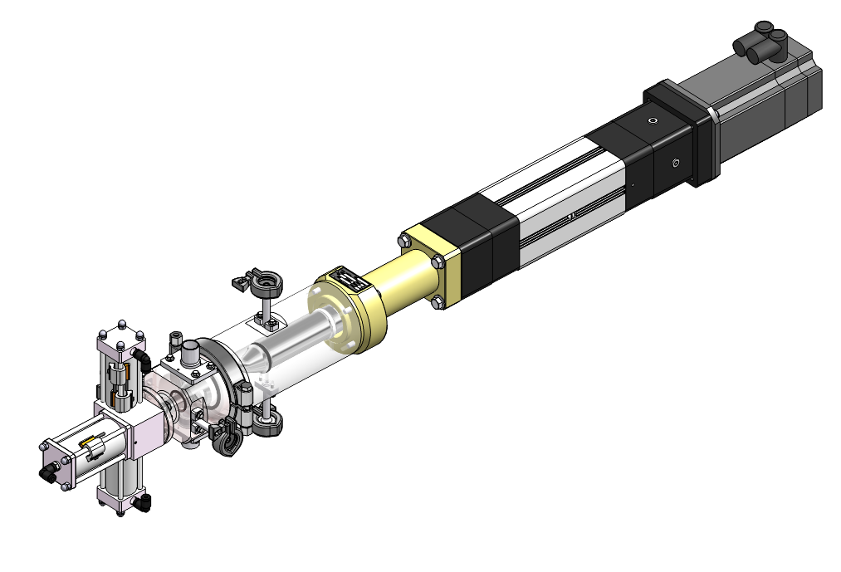
DOSYS PUMP™ - WHAT IS IT?
Motor
Cylinder (body)
Valve actuator (Rotation)
Linear Cylinder
Spacer (Lantern)
Piston
Valve actuator
CIP Position
Valve Head

Slide 10
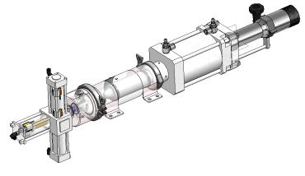
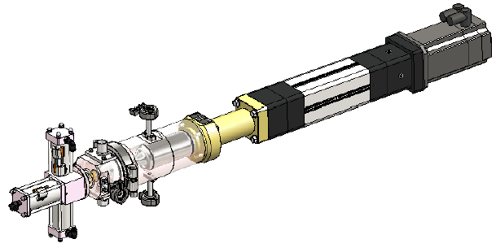
Dosing with PCM DosysTM Pumps
  Protect Valuable Ingredients
    Precision de +/- 0.5% (volumen) Vs. 1% for PCP
    Gentil bombeo
      Hasta 48mm sin daño
    Flexible
    Easy cleaning
      CIP y Sterilization sin bypass

Slide 11
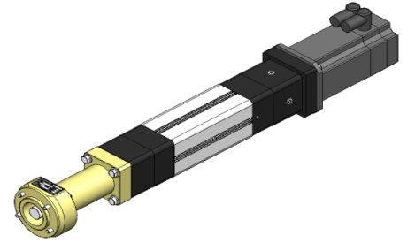
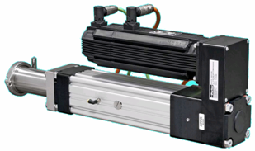

PCM DOSYS™ Bombas de Piston controladas
Las claves para la perfección en llenado y dosificación
PRINCIPIO
0.5% to 100% - rango
Definición programable de ajuste
Mejor Securidad
Mejor contrôle de acceleración de pistón
Menos sensible a cambios de presión
Contrôle de masa
Auto cebante
CIP automatico
Silenciosa

Slide 12
PCM DOSYS™ Bombas de Piston controladas
Las claves para la perfección en llenado y dosificación
RANGO DE RENDIMIENTO
 | Capacitud cc |  |  | Max combinated performance @ 50% volume capacity |  | Max combinated performance @ 100% volume capacity
 | Mínimo | Máximo (100%) |  | Rate (Cycles/minute) |  | Rate (Cycles/minute) | Pressure (bar)
DACC 008/020-008 SMB032 BH FDA | 0,05 | 1,01 |  | 80 |  | 60 | 20
DACC 012/020-008 SMB032 BH FDA | 0,1 | 2,26 |  | 80 |  | 60 | 20
DACC 024/020-008 SMB050 BH FDA | 0,45 | 9,05 |  | 70 |  | 50 | 20
DACC 024/040-016 SMB050 BH FDA | 0,90 | 18,10 |  | 70 |  | 50 | 20
DACC 036/040-016 SMB050 BH FDA | 2,0 | 40,72 |  | 70 |  | 50 | 11
DACC 048/100-023 SMB100 BH FDA | 9,05 | 180,96 |  | 50 |  | 40 | 20
DACC 063/100-023 SMB100 BH FDA | 15,6 | 311,72 |  | 50 |  | 40 | 17
DACC 072/100-023 SMB100 BH FDA | 20,4 | 407,15 |  | 45 |  | 35 | 13
DACC 090/100-035 SMB100 BH FDA | 31,8 | 636,17 |  | 40 |  | 35 | 9
DACC 130/100-048 SMB100 BH FDA | 66,4 | 1327,32 |  | 25 |  | 20 | 4
DACC 130/200-048 SMB100 BH FDA | 132,7 | 2654,64 |  | 20 |  | 15 | 4

Slide 13
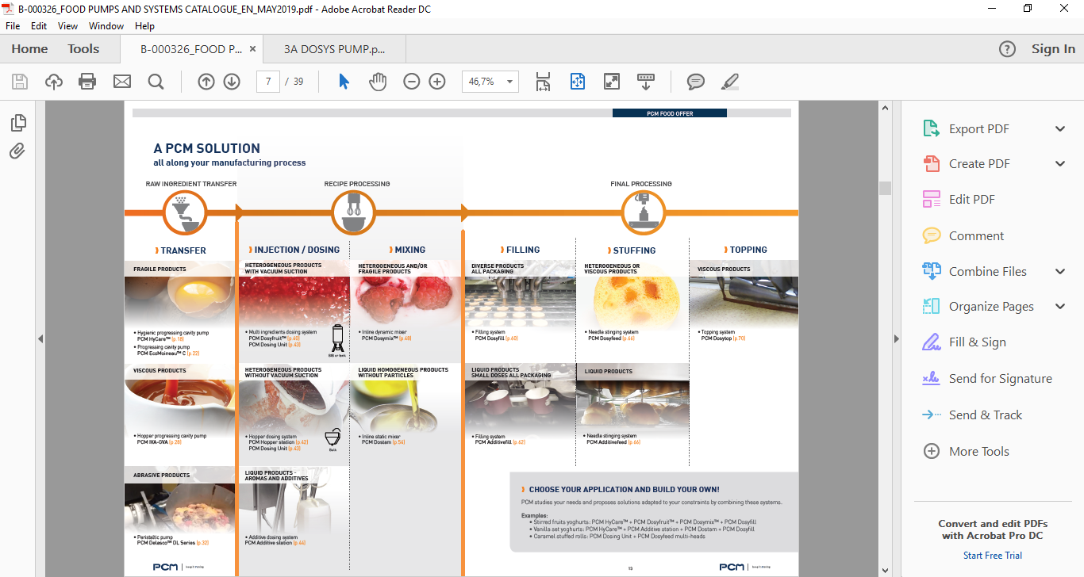
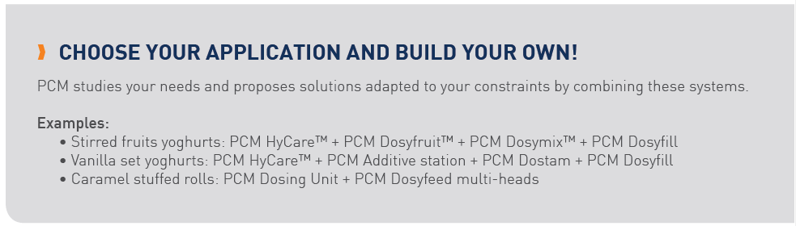
Una SOLUCIÓN PCM a lo largo de su proceso de fabricación.

Slide 14
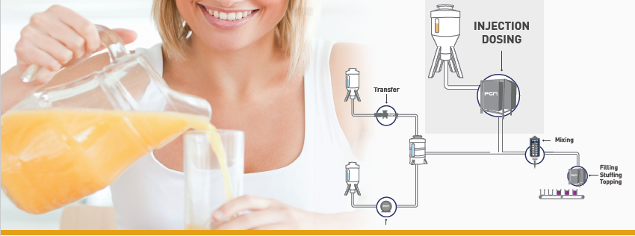
INJECCIÓN Y DOSIFICACIÓN
Nunca desperdicie una gota: precisión y flexibilidad para una productividad sin igual
PCM MOINEAUTM PROGRESSING CAVITY PUMPS
They allow the continuous dosing of fragile ingredients for applications that may require high flowrates
• PCM Dosyfruit™ Premium
• PCM Dosyfruit™ Basic
• PCM Dosing Unit
• PCM Hopper Station
• PCM Additive Station
PCM DOSYS™ PISTON AND CONTROLLED VALVE PUMPS
These pumps enable accurate dosing, closest to the containers, of non homogeneous ingredients that may contain large pieces with minimum losses and a maximum repeatability.

Slide 15
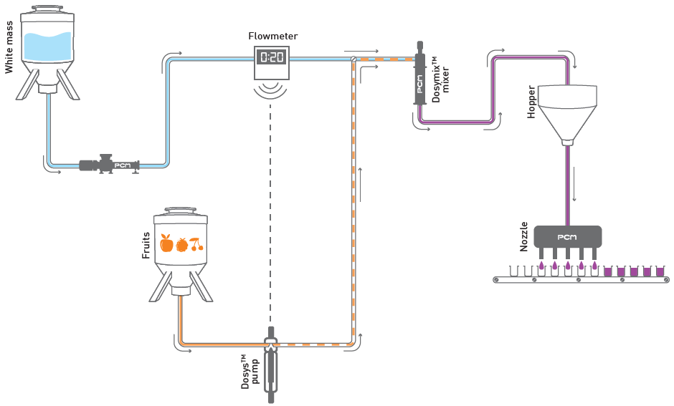
INYECCIÓN Y DOSIFICACIÓN
DIVERSOS PRINCIPIOS DE INYECCIÓN EN LÍNEA
Inyección / mezcla de sabor único en línea (antes de la tolva)
The proportion is always respected regardless the flowrate of the main ingredient.
Notes:
PCM inline injection systems are particularly flexible and provide productivity gains through a fully automated process, including the detection and management of containers ending, the elimination of dilution fronts when the ingredients are changed, and the changes for cleaning processes (CIP).
The injection point is located before the hopper. This is a classic inline process. The dosage is proportional because the additive flowrate (ex: fruits preparation) is controlled by the main ingredient dosage (ex: white mass). A flowmeter measures the flowrate of the main ingredient and orders the Dosys™ pump to send a dose of additive (top dosing). Example of instruction: injection of one dose of additive every 3 liters.

Slide 16
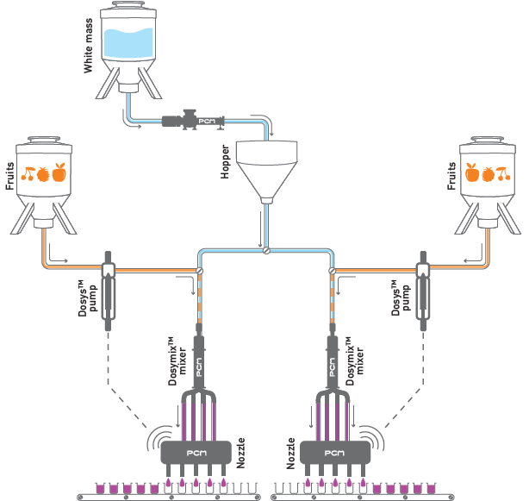
INYECCIÓN Y DOSIFICACIÓN
Inyección / mezcla en línea de sabor único (antes de la tolva)
inyección / mezcla en línea Just-in-time (después de la tolva)
Because the mixing is done at the latest and on request just before the packaging machine, the loss of ingredients is therefore minimal.
Notes:
The injection point(s) are located after the hopper storing the main ingredient. This is a "just in time" process because the dosing pumps, and so the injection of additives (ex: fruits or colourings preparation), are controlled by the packaging machine

Slide 17
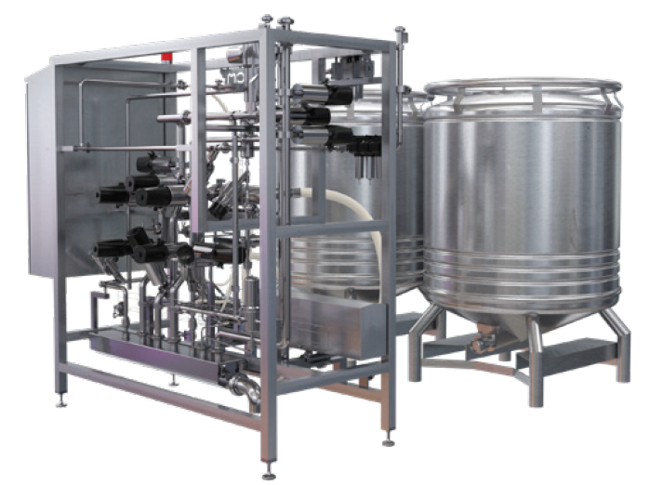

INYECCIÓN Y DOSIFICACIÓN
PCM DOSYFRUIT™ PREMIUM
La referencia en procesos industriales de fabricación de yogur de fruta.
PCM Dosyfruit™ premium is a single or multi-ingredient dosing system with BIB or containers sucking that is fully automated. It is therefore the reference for the injection and dosing of fruit in fresh dairy products.

Slide 18
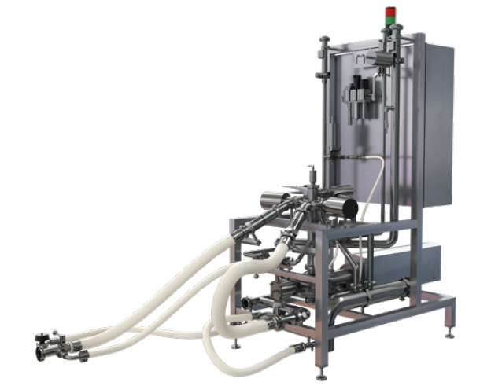
INYECCIÓN Y DOSIFICACIÓN
PCM DOSYFRUIT™ BASIC
Una solución económica para un proceso semiautomático de producción de yogur de fruta.
PCM Dosyfruit™ Uno solo producto (Bag o Bag In Box).
Ex: Yogurt artesanal

Slide 19
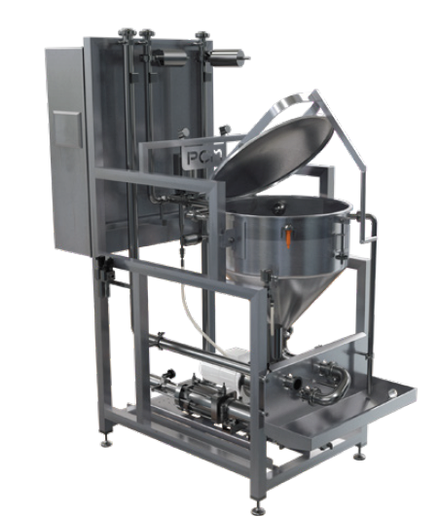
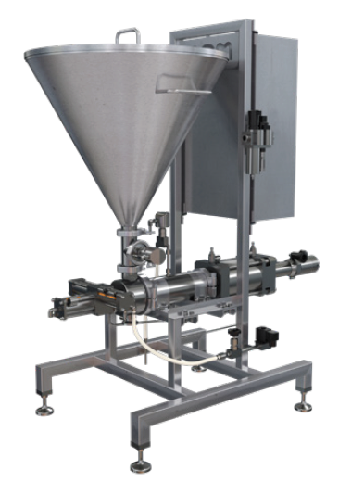
INYECCIÓN Y DOSIFICACIÓN
PCM HOPPER STATION
Una solución “CIPable” con tolva de carga para aplicaciones semi-industriales o artesanales.
Dosaje de productos heterogeneos

Slide 20
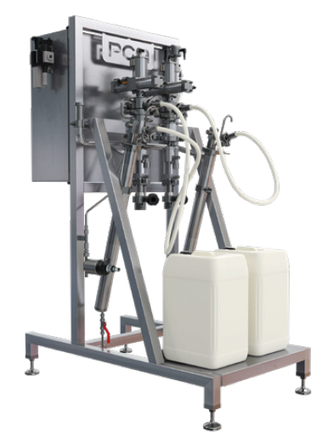
INYECCIÓN Y DOSIFICACIÓN
PCM ADDITIVE STATION
La solución compacta para inyectar pequeñas dosis de líquidos.
The PCM Additive Station is a pumping equipment of single or multi-flavours or liquid additives with drum suction lance. The flavour or additive dose is injected upstream from mixing step into the transfer piping of the main product.

Slide 21
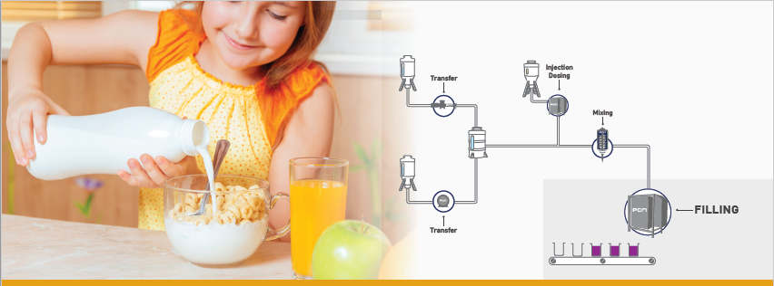
DOSAJE
Control de una dosificación precisa y limpia
PCM Dosyfill
PCM Additivefill
Notes:
Filling refers to the act of filling or dosing into any type of container intended for the final consumer or for use in collective catering.
The implementation of innovative agri-food products requires the availability of a high-performance filling solution that will fulfil with the complexity of mixtures, recipes and packaging techniques. Today, creativity in terms of containers and the diversity of textures to be packaged seems limitless. PCM filling systems are designed to provide the versatility and precision required for these critical operations.
PCM filling systems offer maximum volumetric versatility. You can fill containers of any shape and size, while varying the filling volume considerably from one cycle to the next. The same system can therefore be adapted to fill a wide variety of ingredients: from liquid flavours to the most viscous jams, from sticky caramels to sauces of various sizes.

Slide 22
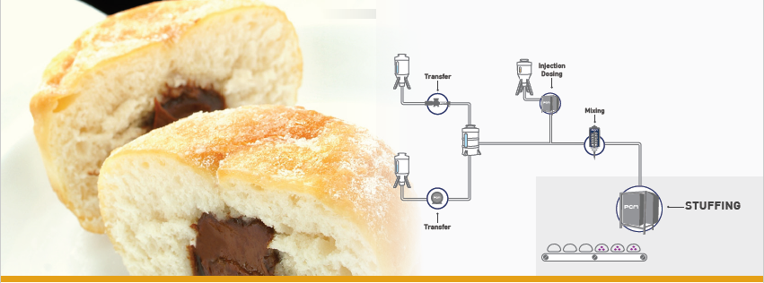
LLENADO
Libertad para ser creativo: ponga sus ideas en producción con versatilidad y mantenimiento de la integridad de los ingredientes.
PCM Dosyfeed
PCM Additivefeed
Notes:
Stuffing refers to the action of injecting a dose of an ingredient into a food preparation.
Many applications of stuffing ingredients, often viscous (fruit preparation) or stringy (caramel), are used in the bakery and pastry sector, such as for example in the manufacture of bread rolls feeding with jam or in the production of profiterol with cream. But there are also applications for stuffing liquid doses to flavour preparations.
To meet these constraints, PCM has different transfer and dosing technologies coupled with quilting systems (stuffing needles).

Slide 23
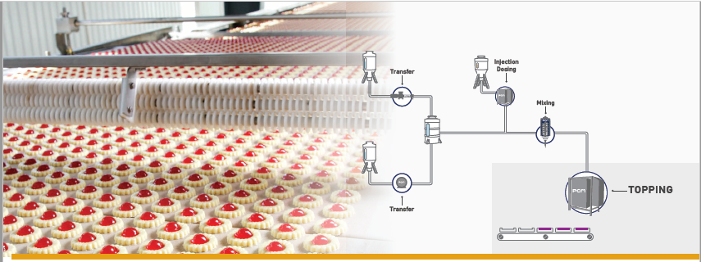
TOPPING
Un último paso delicado en la finalización de tus recetas.
PCM Dosytop
Notes:
Topping means the action of depositing a dose of ingredient to partially or completely cover a food preparation.
This final step is complex because it finalizes your preparation, it must not risk any imperfection.
For this delicate step, the dosing and transfer technologies are the same as in previous applications but differ by the use of specific nozzles.

Slide 24
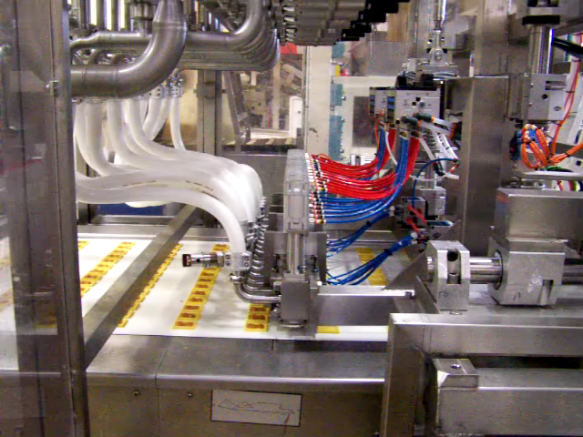

Slide 25
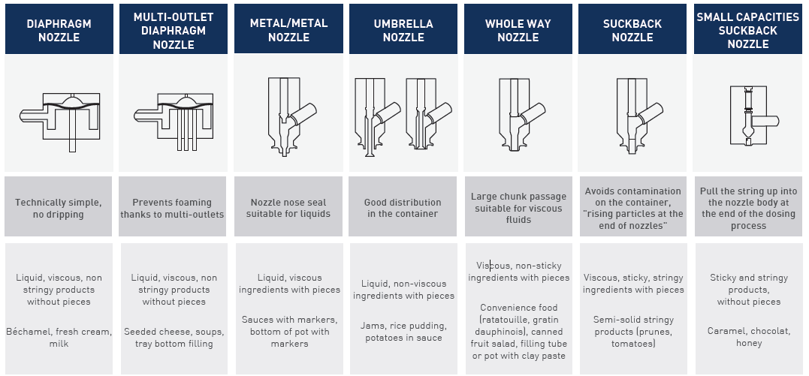
FILLING
La ejecución controlada de una dosificación limpia y precisa.

Slide 26
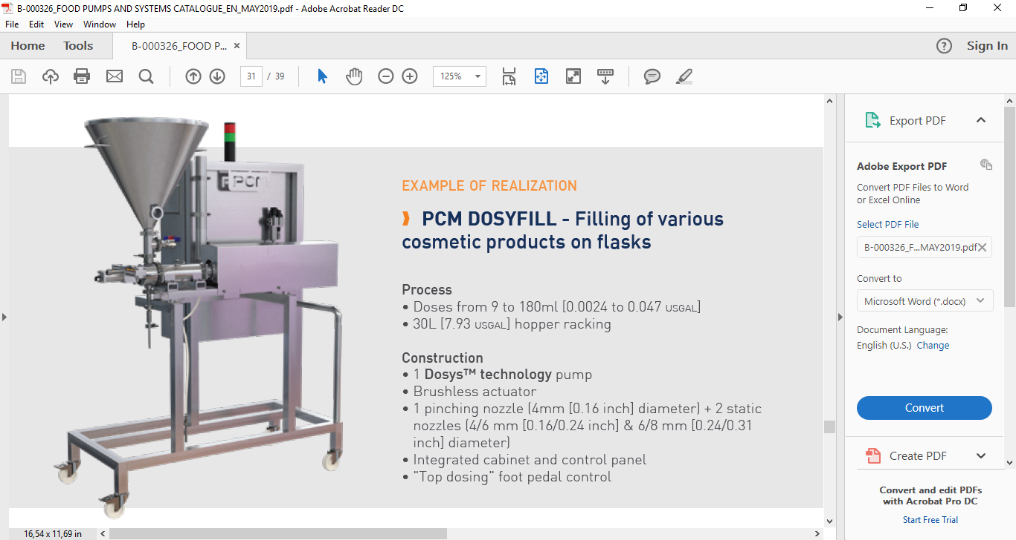
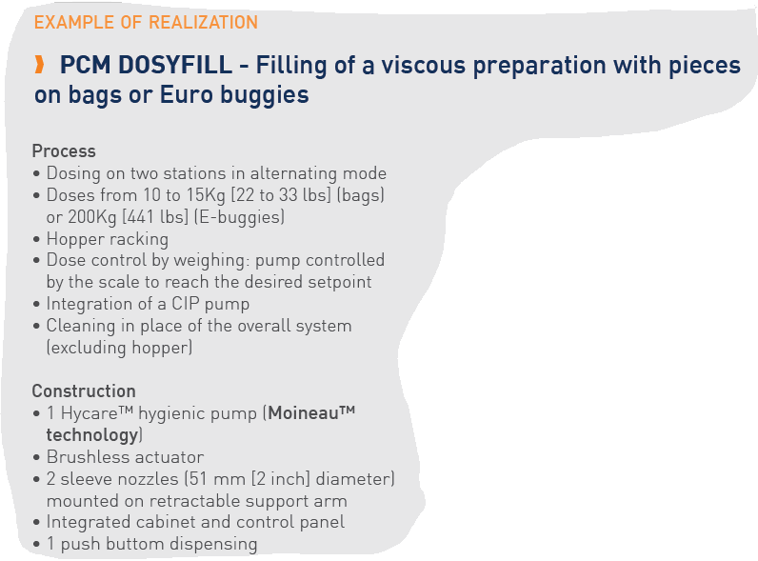
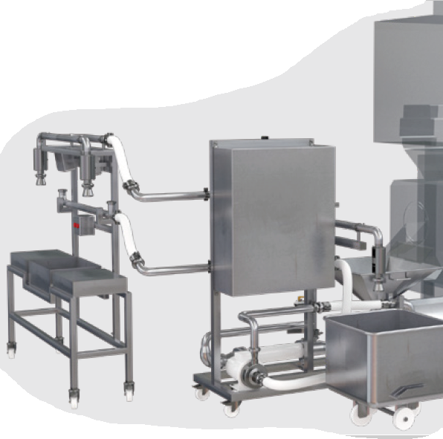
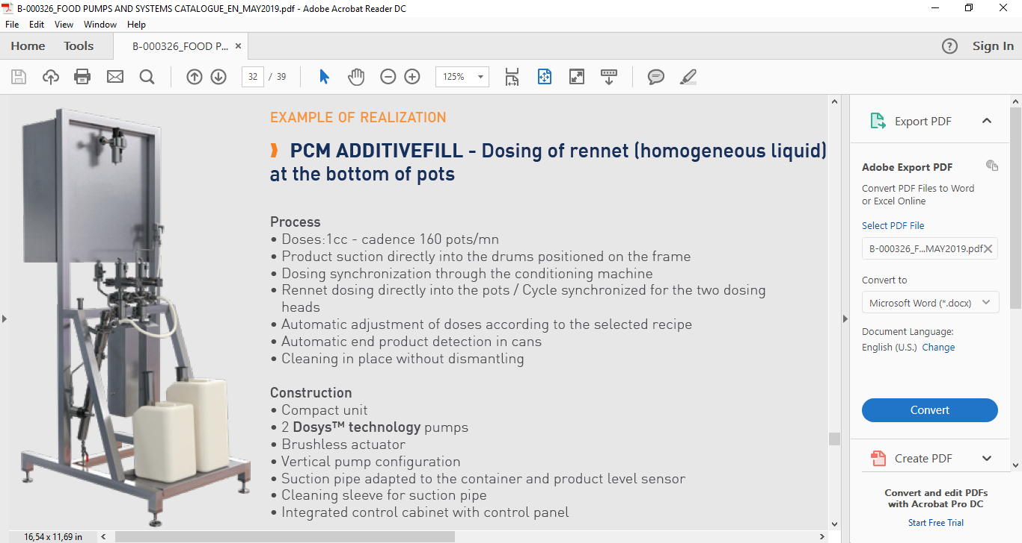
FILLING
PCM DOSYFILL & ADDITIVEFILL
Soluciones compactas de dosificación y llenado para ingredientes líquidos

Slide 27
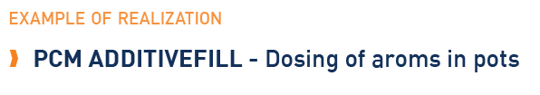
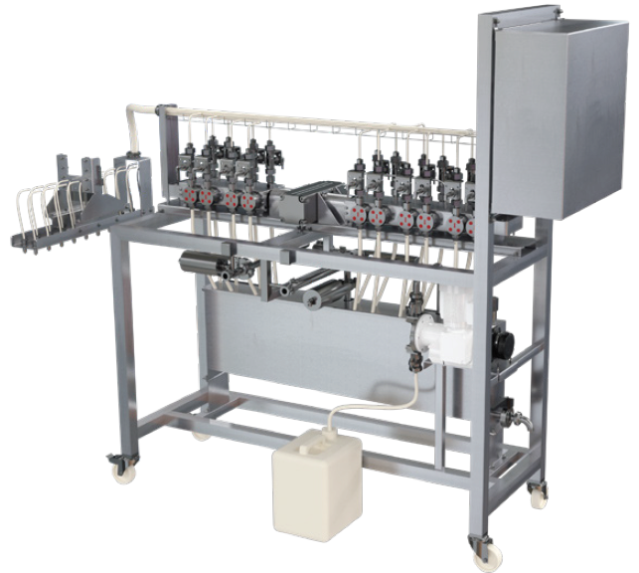
FILLING
PCM ADDITIVEFILL
Soluciones compactas de dosificación y llenado para ingredientes líquidos.

Slide 28
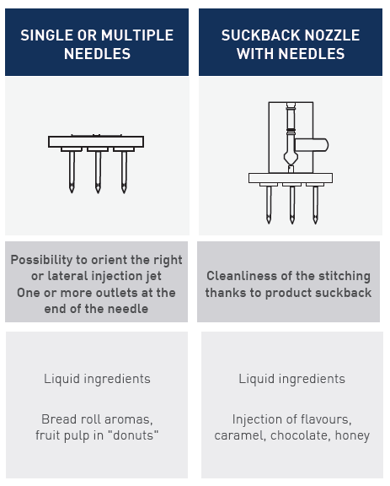
STUFFING
Libertad para ser creativo: ponga sus ideas en producción a través de la versatilidad y el mantenimiento de la integridad de los ingredientes.

Slide 29
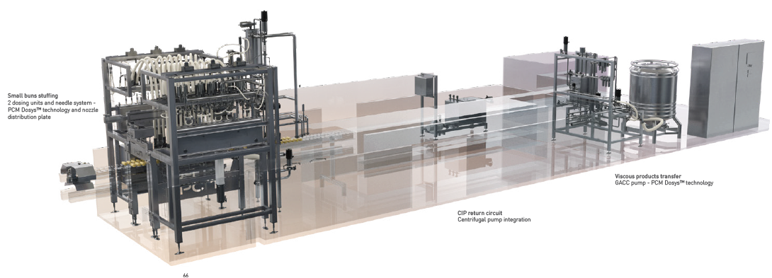
STUFFING
PCM DOSYFEED & ADDITIVEFEED
Soluciones "Turnkey" para el relleno de sus productos

Slide 30
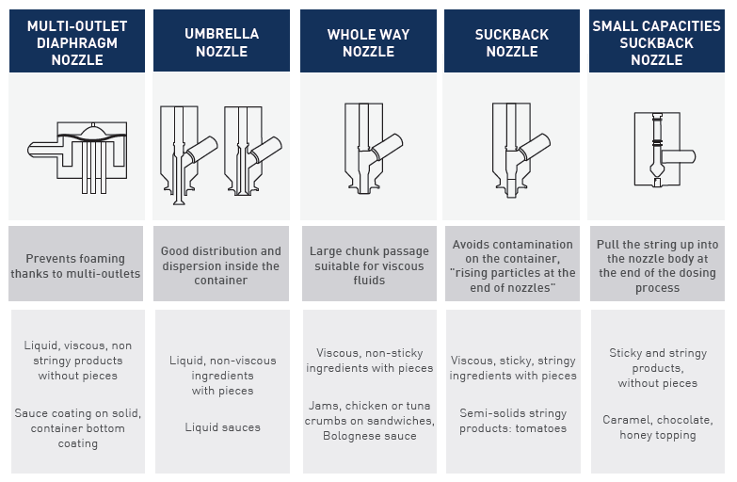
TOPPING
Un toque definitivo y delicado en la finalización de sus recetas.

Slide 31
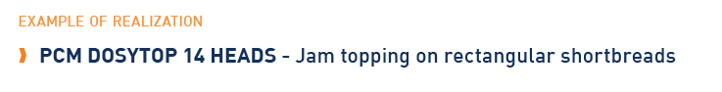
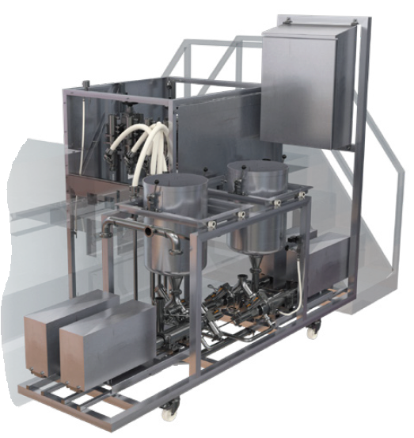
TOPPING
PCM DOSYTOP
Soluciones en Cobertura que se adaptan a la finalización de sus recetas

Slide 32
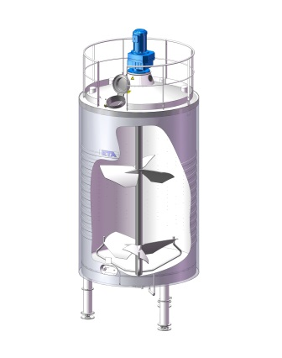
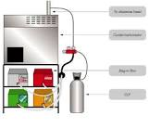
EN DOSIFICACION HAY DOS MODOS
BATCH = dosificando y mezclando en tanques
IN-LINE = En línea dosificando y mezclando
- In-Line Injection
- “Just in Time” Injection

Slide 33
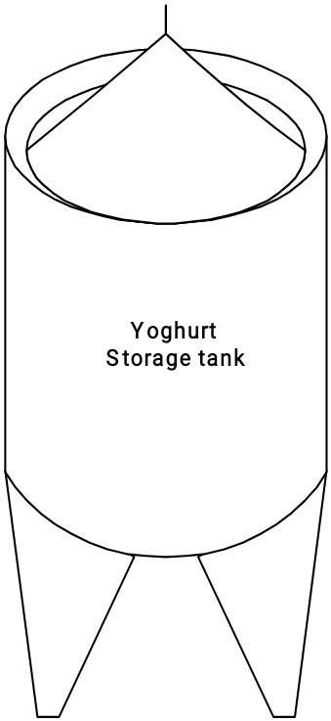
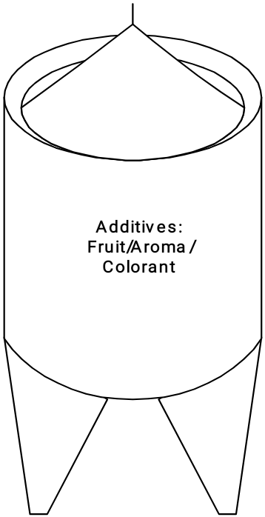


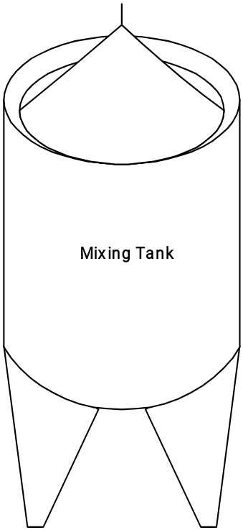


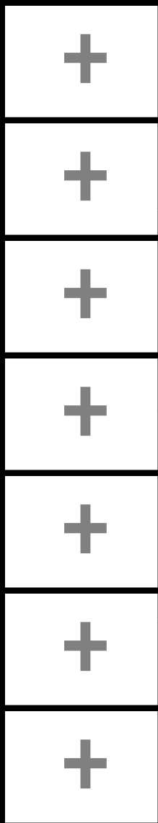
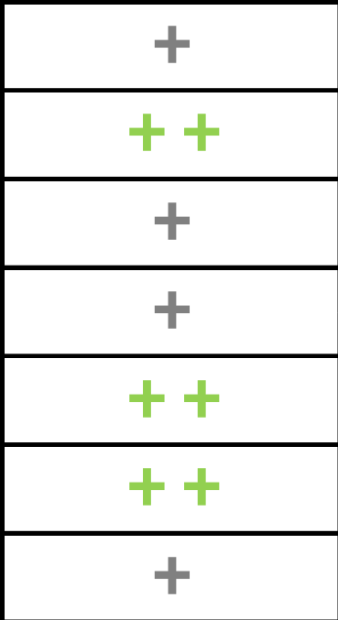
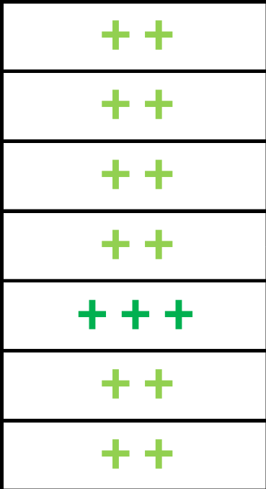
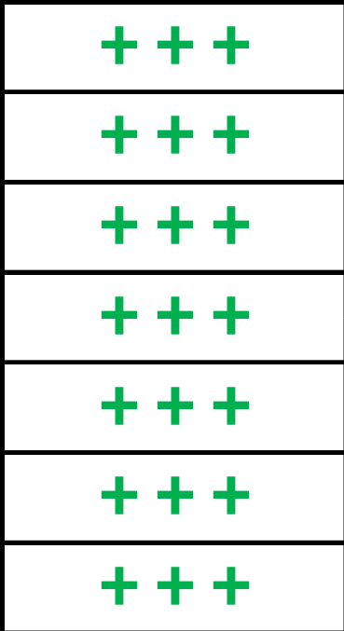

Batch
In-line Proportional
Continuous Mode / Proportionnal Dosing
In-line
Additive pulsed mode / In-line Injection
In-line JIT
Pulsed Mode / Just in time
WM
A
WM
WM
A
WM
A
A
DACC
Buffer
Tank
Mixing Tank
DM
DACC
DM
Dosing
Top
DM
Dosing
Top
Buffer Tank
Dosyfill
Conditioning
Conditioning
Conditioning
Conditioning
Additive dosing precision
Mixing efficiency
Product integrity
Flexibility
Dimensions
Utilities consumption
Total cost of ownership
Notes:
Batch mixing efficiency is less because of the mass in the tank that is a long to mix.
Meter flow: if the flow of White Mass (WM) increases, the flow rate of the Additive (A) increases and is proportional to the WM (assay 10% for example). Also referred to as "control loop".
Consumption of utilities: Annexes consumption: water, cleaner
More flexibility to plan production
avoiding the installation of a mixing tank:
Economic Gain
Space saving
Cleaning efficiency
allows manufacturing of small batches
promotes creativity (less loss during tests) and the release of new recipes

Slide 34
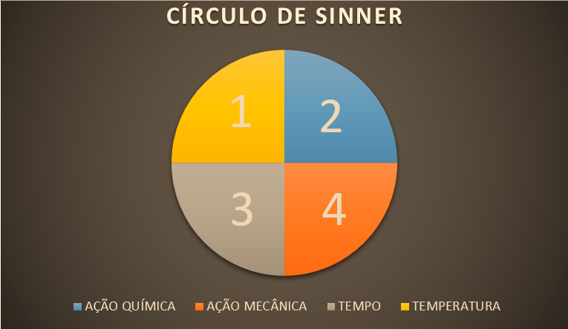
!IMPORTANTE!

Slide 35
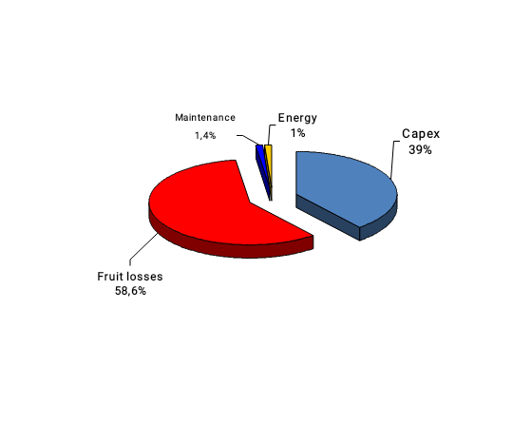

VALOR AGREGADO
Reducción en Perdida de Productos:
Perdida de producto puede representar cientos de miles de dólares por ano y por línea de producción
2% de sobre dosificando en yogures cuestan ??? USD
Sistemas de PCM han sido diseñados para minimizar perdidas durante dosificando, pero también en otras fases como cebando, cambio de producción/producto, empuje de agua al final de producción

Slide 36
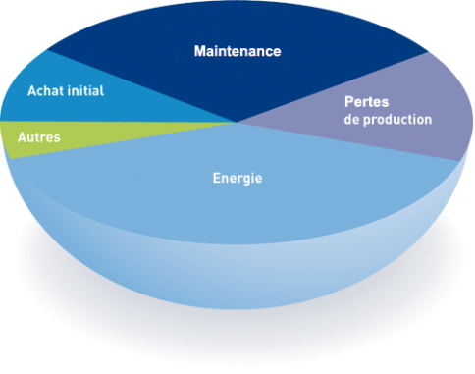
VALOR AGREGADO
Reducción Costo Total de Propiedad:
Facilidad de CIP de DOSYS puede ahorrar tiempo para operador.
Este valor es mas importante con producciones en donde hay varios cambios por turno, día, semana, etc.
Equipos de PCM pueden transferir, dosificar, mezclar y llenar sin dañar el producto.

Slide 37
VALOR AGREGADO
Objetivos de PCM dan Valor Agregado:
Establecer soluciones adecuadas cuando hay dificultades en producir con ingredientes complejos
Mantener la integridad del producto
Incrementar producción
Minimizar el impacto de la instalación
Notes:
Work with customer to understand specific needs
Implement over 80 years of experience in manufacturing and systems design
Apply best sanitary design guidelines (3-A, EHEDGE) and food safety laws and regulations (FDA, EU 1935/2004, etc) in our design/manufacturing/operating process
Manufacture products in a controlled environment under ISO quality management guidelines
Move from a batch type system to a continuous automated process

Slide 38
EN RESUMEN
Los sistemas alimentarios de PCM ofrecen una variedad de beneficios para el cliente
Precisión y Repetibilidad
Facilidad de CIP/SIP
Minimización de la pérdida de productos
Respeto de los productos que son sensibles al cizallamiento y que incluye trozos de fruta

Slide 39
CASES!

Slide 40
DOSYFRUIT™
AUTOMATIC CONTAINER CHANGE OVER
White Mass
PCM Moineau™ Pump
Fruit A
Fruit B
Injection
Mixer
Dosyfruit™ (Dosys™)
Filling
Dosymix™ (Dosys™)
Dosyfill(Dosys)

Slide 41
1 . Fruit pump priming
White Mass
PCM Moineau Pump
Fruit A
Fruit B
Injection
Mixer
Dosyfruit (Dosys)
Filling
Dosymix (Dosys)
Dosyfill(Dosys)

Slide 42
White Mass
PCM Moineau Pump
Fruit A
Fruit B
Injection
Mixer
Dosyfruit (Dosys)
Filling
...up to the injection point
Dosymix (Dosys)
Dosyfill(Dosys)

Slide 43
2. White mass pump priming
White Mass
PCM Moineau Pump
Fruit A
Fruit B
Injection
Mixer
Dosyfruit (Dosys)
Filling
Dosymix (Dosys)
Dosyfill(Dosys)

Slide 44
White Mass
PCM Moineau Pump
Fruit A
Fruit B
Injection
Mixer
Dosyfruit (Dosys)
Filling
3. The dosing can start
Dosymix (Dosys)
Dosyfill(Dosys)

Slide 45
In the same time, a second container can be primed
White Mass
PCM Moineau Pump
Fruit A
Fruit B
Injection
Mixer
Dosyfruit (Dosys)
Filling
Dosymix (Dosys)
Dosyfill(Dosys)

Slide 46
When the container and the pipes are empty ...
White Mass
PCM Moineau Pump
Fruit A
Fruit B
Injection
Mixer
Dosyfruit (Dosys)
Filling
Dosymix (Dosys)
Dosyfill(Dosys)

Slide 47
...We change the container over without any production shutdow. We can then « push » the fruit A with the fruit B.
White Mass
PCM Moineau Pump
Fruit A
Fruit B
Injection
Mixer
Dosyfruit (Dosys)
Filling
Dosymix (Dosys)
Dosyfill(Dosys)

Slide 48
White Mass
PCM Moineau Pump
Fruit A
Fruit B
Injection
Mixer
Dosyfruit (Dosys)
Filling
Dosymix (Dosys)
Dosyfill(Dosys)

Slide 49
White Mass
PCM Moineau Pump
Fruit A
Fruit B
Injection
Mixer
Dosyfruit (Dosys)
Filling
Dosymix (Dosys)
Dosyfill(Dosys)

Slide 50
White Mass
PCM Moineau Pump
Fruit A
Fruit B
Injection
Mixer
Dosyfruit (Dosys)
Filling
Dosymix (Dosys)
Dosyfill(Dosys)

Slide 51
In the same time, we can replace the empty container with a full one
White Mass
PCM Moineau Pump
Fruit B
Fruit B
Injection
Mixer
Dosyfruit (Dosys)
Filling
Dosymix (Dosys)
Dosyfill(Dosys)

Slide 52
And so on…thus, you produce with minimum fruit losses and with lower manpower
White Mass
PCM Moineau Pump
Fruit B
Fruit B
Injection
Mixer
Dosyfruit (Dosys)
Filling
Dosymix (Dosys)
Dosyfill(Dosys)

Slide 53
At the end of production, the Dosyfruit starts pushing the fruit with water.
White Mass
PCM Moineau Pump
Fruit B
Fruit B
Injection
Mixer
Dosyfruit (Dosys)
Filling
Dosymix (Dosys)
Dosyfill(Dosys)

Slide 54
CONCLUSION….No fruit losses….
White Mass
PCM Moineau Pump
Fruit B
Fruit B
Injection
Mixer
Dosyfruit (Dosys)
Filling
Dosymix (Dosys)
Dosyfill(Dosys)
Notes:
Nous sommes à la fin !!

Slide 55
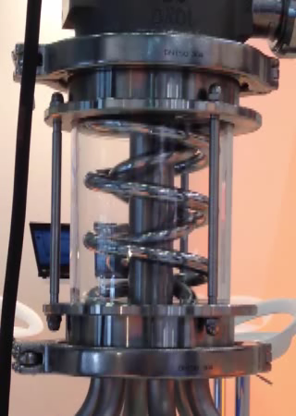
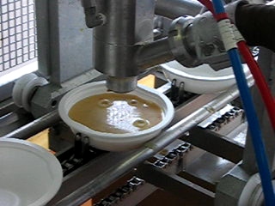
VIDEOS – EXTRA CONTENT

