Slide 1

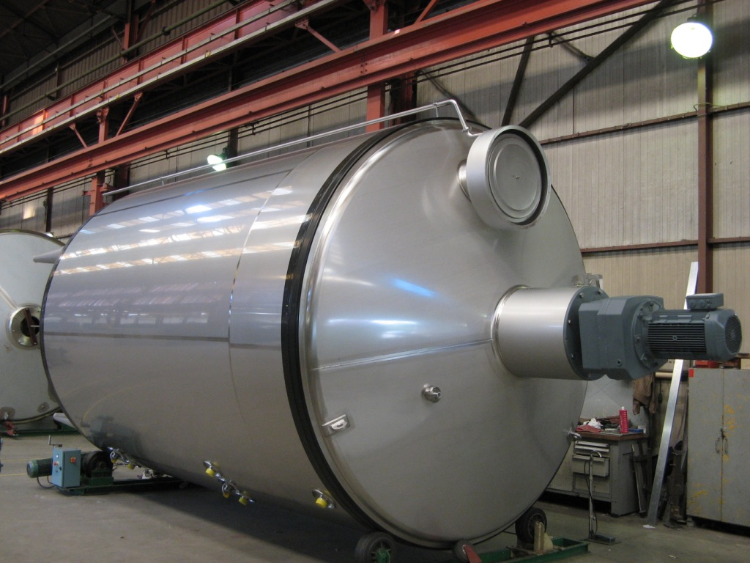
Crystallization tanks
Chaudronnerie, Conception,
Installation, Automatisation
116 rue d’Argentan - CS 20205
61006 ALENÇON CEDEX - FRANCE
Tél. : +33 (0)2 33 81 30 00
Fax : +33 (0)2 33 31 05 19
www.goavec.com – contact@goavec.com

Slide 2
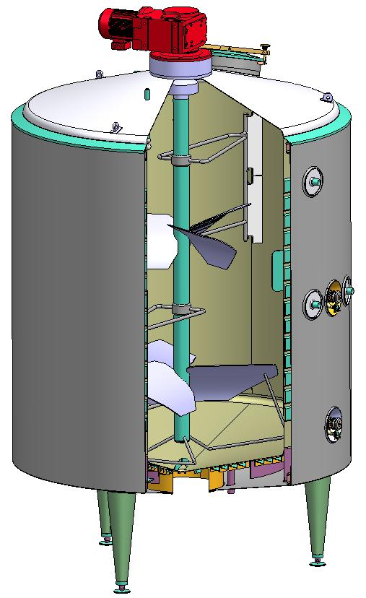

Our crystallizers have already been manufactured in
1 500 up to 50 000 l. capacities. These tanks are adapted for the treatment of whey in order to obtain:
Whey powder
Lactose powder

Slide 3
characteristics
A specific agitation design allowing a very efficient mixing and thus a good homogeneity with a low speed.
A double cooling jacket on wall and bottom with a high exchange efficiency allowing a great variety of cooling curves.
Tank proportions studied to improve the ratio volume / cooling surface with an optimized cost.
A strong design and a manufacturing quality always improved allowing some of our tanks to be still in production after more than 30 years.
A very simple and easy maintenance to be operated.
Equipment and accessories designed and manufactured in GOAVEC Eng. workshops and really adapted to the treated product.

Slide 4
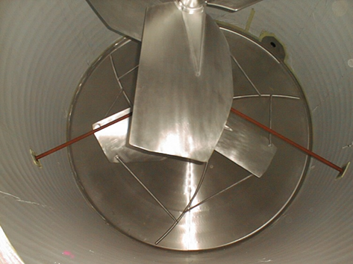
agitation
A specific agitation system, designed according to the density, the viscosity and the dry matters of the product. It is entirely designed and manufactured in the GOAVEC Eng. workshops.
1 or several levels of large surface three-bladed propellers to improve the cooling efficiency.
Bottom pulsors to guarantee the homogeneity of the product till the end of the emptying and to prevent from any decantation risk.
The absence of guiding at the bottom of the shaft improves the cleanability and the maintenance.
A simple lip gasket and an oil deflector prevent from any risk of introduction of oil coming from the motor reducer inside the tank. This oil is as a standard execution a food grade oil.

Slide 5
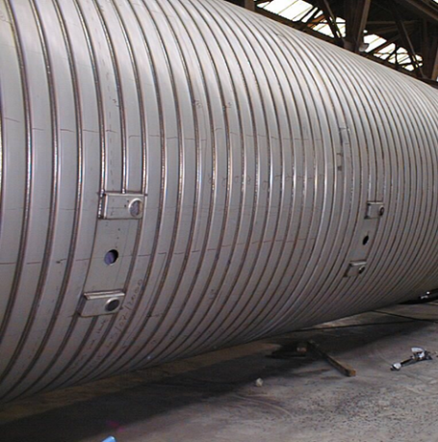
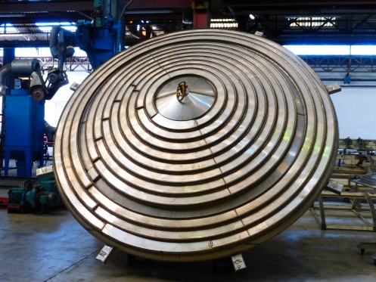
COOLING JACKET
An optimized surface by using a trapezoidal channel automatically welded with a tight distance between the successive turns.
A surface split in several sections to limit the pressure drop and the temperature increase of the cooling fluid.
A maximized surface on the bottom of the tank to improve the cooling exchange, even in the area where the feet of the tank are located.

Slide 6
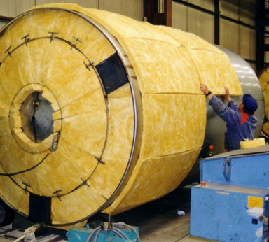
OPTIMIZED PROPORTIONS
Although all the alternatives are possible, harmonious proportions are a guarantee of optimization of the ratio between the surface and the volume improving the efficiency of the product treatment with an excellent stability and an optimized cost. The slope of the bottom is adapted to the rheology of the product to guarantee a minimum of loss during the draining.
An effective wall and bottom insulation of the tank with uncrushable and chlorine free glass wool or rock wool allows energy savings and an exceptional durability. Some of our crystallization tanks have been working for more than thirty years for the greatest satisfaction of their users.

Slide 7
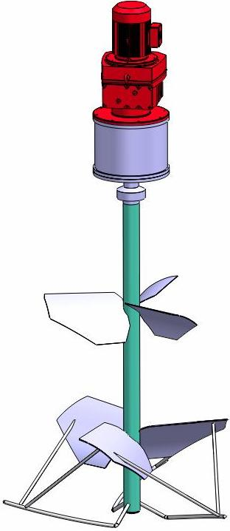
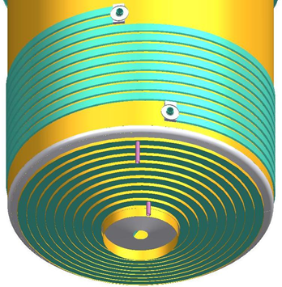
DESIGN
Steel thicknesses calculated in the same conditions as if it was for pressure vessels.
A stiff support insuring a perfect transfer of the stresses.
A widely sized agitation system connected to the tank by a stiff turret allowing a perfect transfer of the efforts to the tank itself without any lower guide.
Cooling circuits designed to resist during years and years to the pressure and the thermal stresses. All double jackets are subject to a pressure test at 1.6 time the working pressure before insulation.
Sanitarity and cleanability are a permanent concern, as for every GOAVEC Engineering equipment.

Slide 8
MANUFACTURING QUALITY
During the manufacturing process, GOAVEC Engineering crystallizers are subject to many controls to ensure an optimal construction quality.
Following and quality control of the incorporated products.
Qualified welding procedures.
Qualified welders.
Dye penetration tests on all manual welds.
Control and correction of the righteousness of the agitation shaft.
Hydraulic test of the cooling jacket.
Statistic control of the surface rugosity.
Control of the dimensions and the conformity to the drawing before shipment.
Adapted packing according to the final destination.

Slide 9
MAINTENANCE
GOAVEC Engineering crystallizers require a very low maintenance limited to the exchange of some gaskets (manhole, retractable cleaning device, sample valve and various probes…).
The replacement of the simple lip seal of the agitation is the only operation requiring the dismounting of the motor reducer. Our recommendation is to change it every 12 months or 2 000 working hours but actually very few customers respect this recommendation as this gasket is able to work many years before being replaced.
The absence of bottom guiding is an outstanding element of the quality of our crystallizing tanks. Indeed it allows a total absence of maintenance at this level and avoids the draining difficulties due to the structure of the product in a zone in which the agitation is necessarily less efficient.

Slide 10
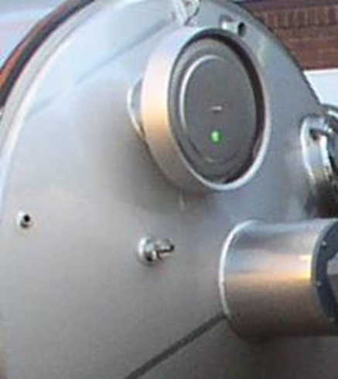
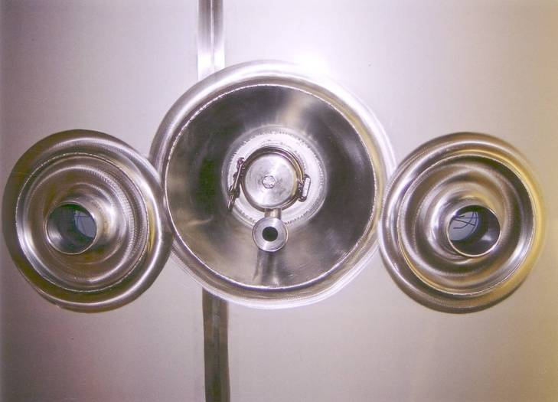
ACCESSORIES
GOAVEC Engineering designs and manufactures many specific accessories for their tanks and especially for the crystallizers, the safety vents and the retractable cleaning devices.
The design and the in-house manufacturing of all the elements in connection with the control of the process is certainly one of the main reasons of the international reputation of the GOAVEC crystallizing tanks.

Slide 11
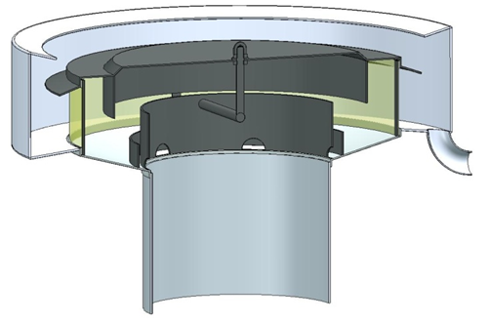
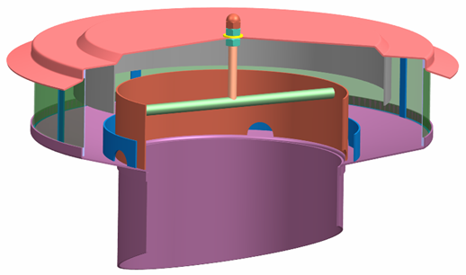
ACCESSORIES
Atmospheric vent:
It exists in Ø 100, Ø 200 and Ø 350 mm according to the volume and the cleaning conditions of the tanks.
Equipped with an anti-insect sleeve and chicanes to avoid liquid projections, it can be equipped with a projection recovering pipe coming down to the bottom of the tank.
It prevents the tank from any risk of overpressure or depression that can generate a collapse.

Slide 12
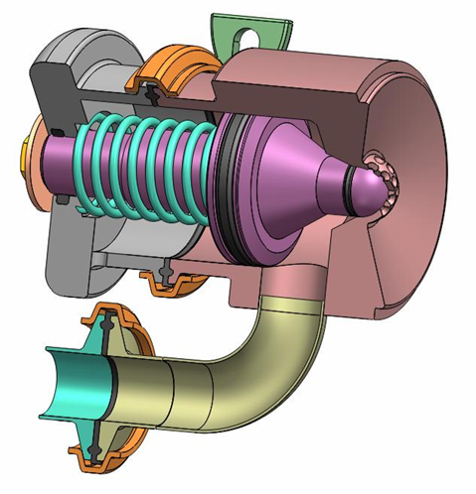
ACCESSORIES
Retractable cleaning device:
Originally developed for the crystallization tanks, the rectractable cleaning device is operated by the pressure of the cleaning fluid and does not require any external actuator. This equipment is used in various industries, even for pharmaceutical reactors.
On demand it can be equipped with an external actuator and/or with position switches.
It is installed at each propeller level to ensure a perfect cleaning under the agitation blades.
Without any part inside the tank surface, it is perfectly adapted in the case of agitation systems with wall scrapers.

Slide 13
REFERENCES
More than 600 units successfully installed worldwide, from 1.5m3 to 50m3 capacity, in operation for some for more than 40 years :
LEPRINO (USA), AGROPUR (Canada), LALA (Mexico), FONTERRA (New Zealand), ARLA CORDOBA (Argentina), and of course within Europe in Germany (BMI, MOLKEREI MEGGLE, WHEYCO, SACHSENMILCH…), Denmark (ARLA), Finland (VALIO), Norway (TINE), Ireland (GLANBIA, DAIRYGOLD…), Lithuania, Spain, Italy, Hungary, etc.

