Slide 1

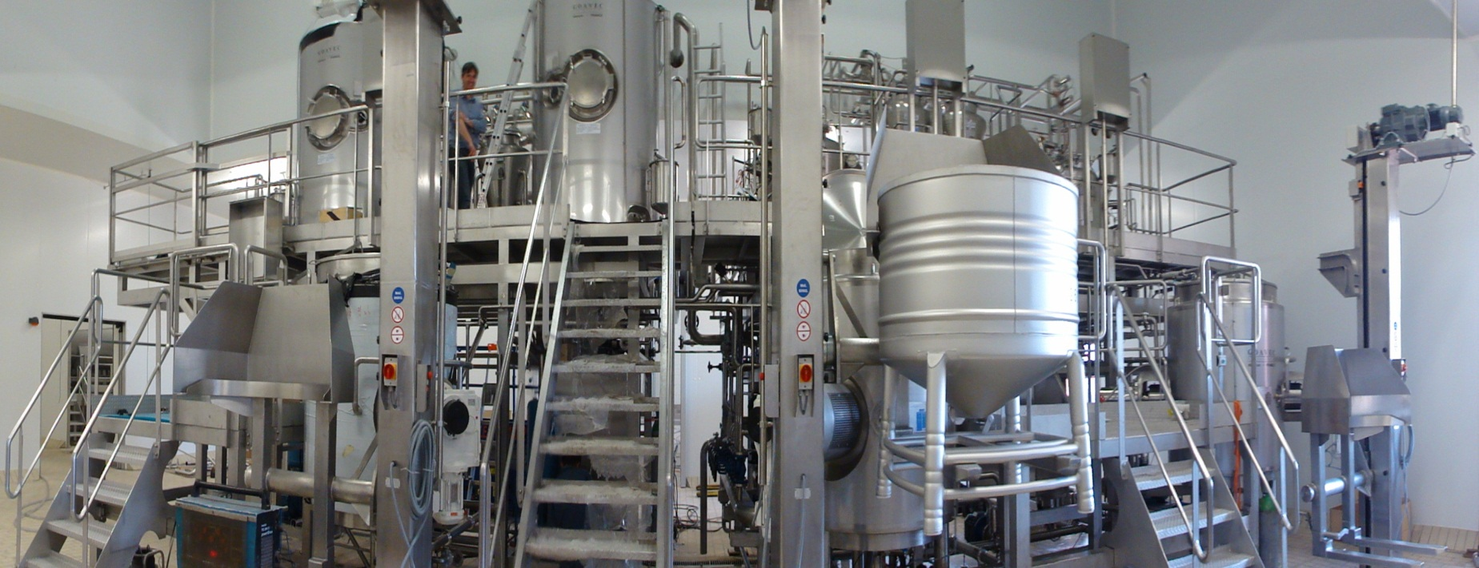
CHEESE APPLICATIONS

Slide 2

FROMAGERIES BEL
LE Mans (France)
CHEESE BASE TEXTURIZING TANK

Slide 3
PRODUCT :
CHEESE BASE
TEMPERATURE (25 TO 75°C)
VISCOSITY (2,000 to 6,000cP)
TANK :
VERTICAL
ATMOSPHERIC
ISOLATED
SINGLE JACKET
120°C CONICAL BOTTOM
CAPACITY : 600l.

Slide 4
AGITATION :
VERTICAL, CENTRAL, WITHOUT GUIDING BEARING
ANCHOR TYPE + PITCHED BLADES + SCRAPERS
10RPM ROTATION SPEED (WITH TORQUE METER)
1.1KW MOTOR
SEE DWG A14451

Slide 5
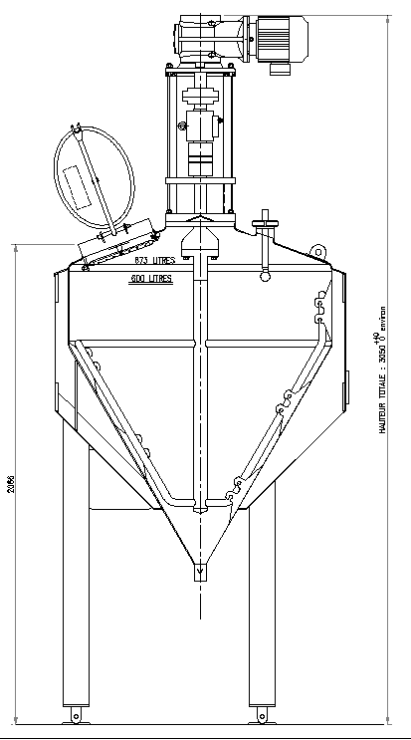
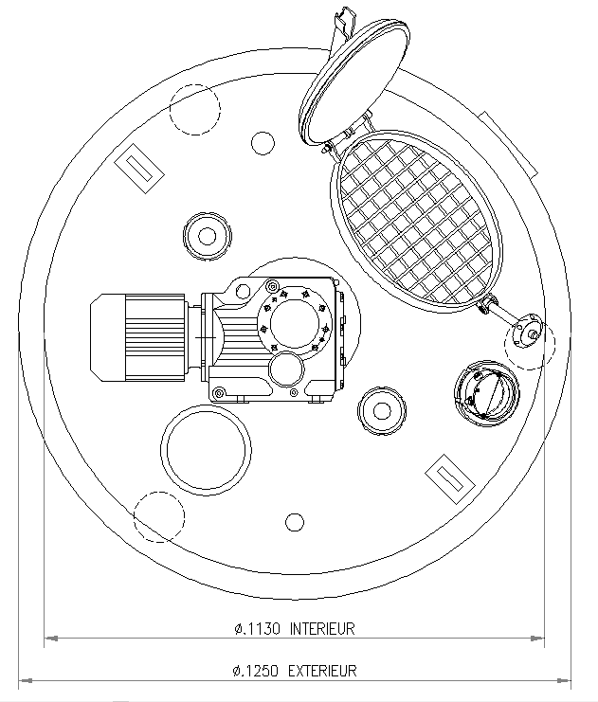

Slide 6
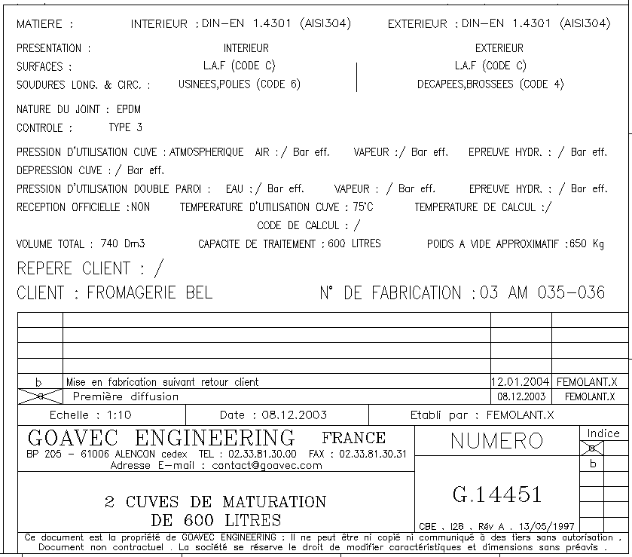

Slide 7
BOURSIN
Croisy Sur Eure (France)
CHEESE PASTE PREPARATION TANK

Slide 8
PRODUCT :
CHEESE PASTE + GARLIC, SALT, PEPPER, HERBS
TEMPERATURE 60°C
VISCOSITY (8,000cP)
TANK :
VERTICAL
ATMOSPHERIC
ISOLATED
DOUBLE JACKET
CAPACITY : 450l.

Slide 9
AGITATION 1 :
VERTICAL, CENTRAL, WITHOUT GUIDING BEARING
ANCHOR TYPE + SCRAPERS
15RPM ROTATION SPEED (WITH FREQUENCY INVERTER)
1.5KW MOTOR
AGITATION 2 :
VERTICAL, OFF-SET, WITHOUT GUIDING BEARING
PITCHED-BLADE TURBINE TYPE
35RPM ROTATION SPEED (WITH FREQUENCY INVERTER)
0.55KW MOTOR
SEE DWG A14228
ail, sel, poivre, persil, ciboulette

Slide 10
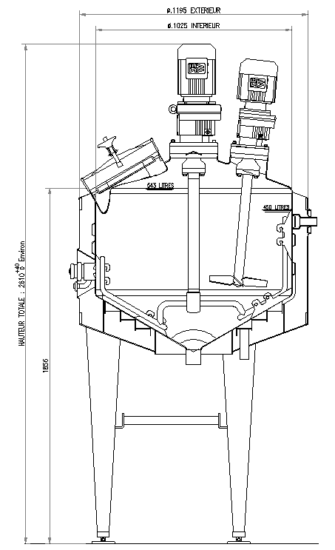
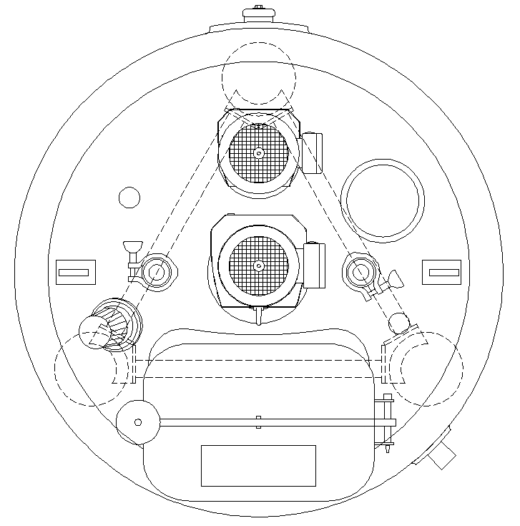
ail, sel, poivre, persil, ciboulette

Slide 11
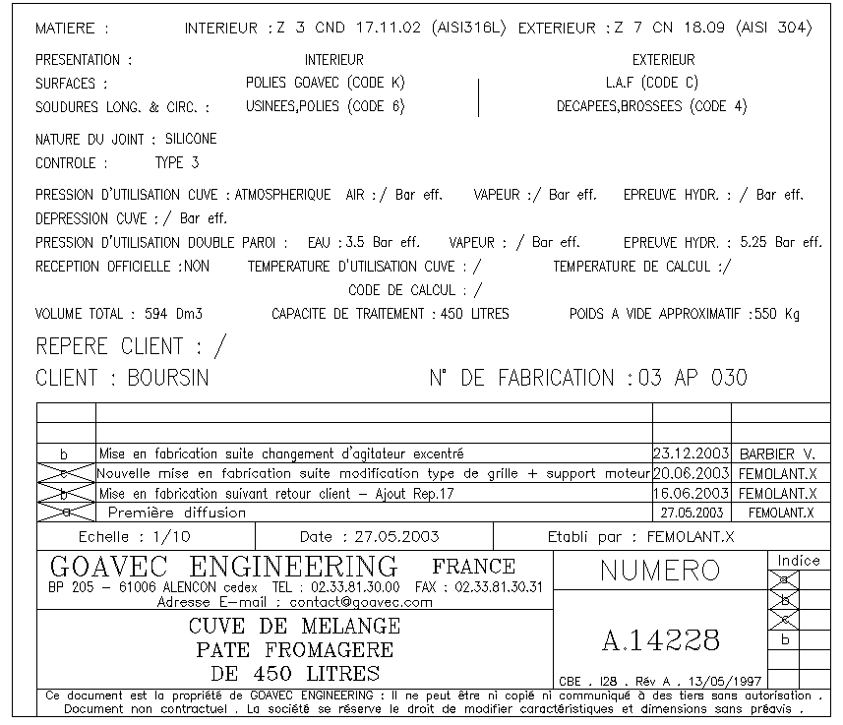
ail, sel, poivre, persil, ciboulette

Slide 12
EPI BRETAGNE
Yffignac (France)
MOLTEN CHEESE TANK

Slide 13
PRODUCT :
MOLTEN CHEESE (Emmental, goat-cheese, etc) + CREAM
TEMPERATURE 40°C
VISCOSITY (6,000cP)
TANK :
VERTICAL
ULTRA-CLEAN (+0.49BAR, -1BAR)
ISOLATED
DOUBLE JACKET
CAPACITY : 2000l.

Slide 14
AGITATION :
VERTICAL, CENTRAL, WITHOUT GUIDING BEARING
ANCHOR TYPE + PITCHED-BLADES & SCRAPERS
25RPM ROTATION SPEED (WITH FREQUENCY INVERTER)
4KW MOTOR
SEE DWG A12872
ail, sel, poivre, persil, ciboulette

Slide 15
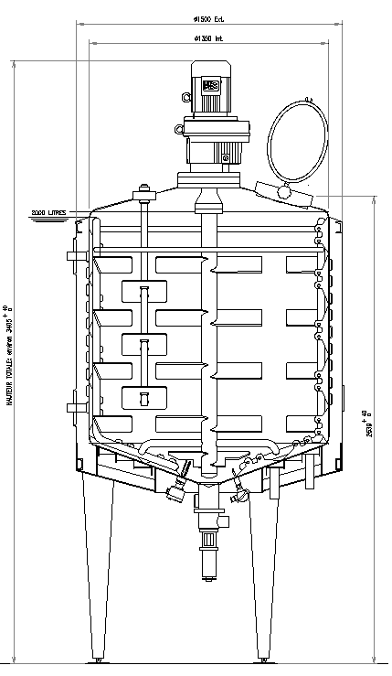
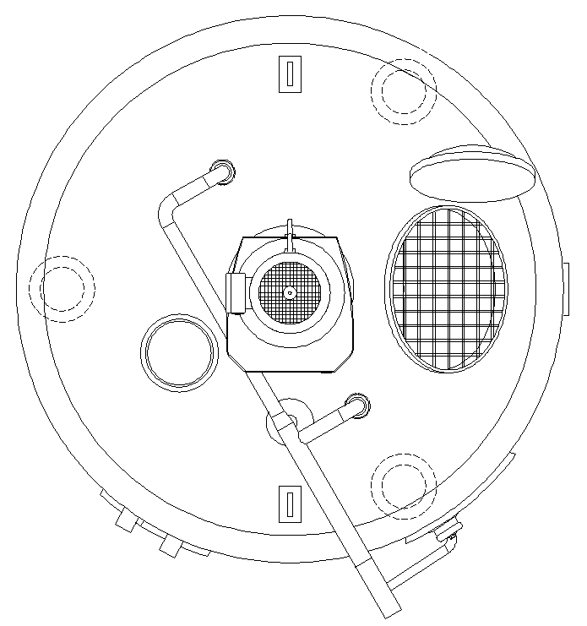
ail, sel, poivre, persil, ciboulette

Slide 16
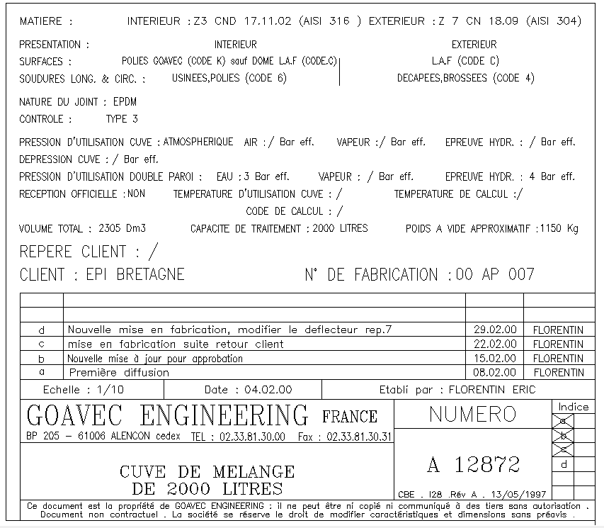
ail, sel, poivre, persil, ciboulette

Slide 17
NOVANDIE
Auneau (France)
WHITE CHEESE MIXING TANK

Slide 18
PRODUCT :
WHITE CHEESE « Fromage Blanc » + EGGS, STARCH, FLAVOURS
TEMPERATURE 4°C
VISCOSITY (3,000cP)
TANK :
VERTICAL
ULTRA-CLEAN (+0.49BAR, -1BAR)
NON ISOLATED
SINGLE JACKET
CAPACITY : 800l.

Slide 19
CONTRA-ROTATION AGITATION 1 :
VERTICAL, CENTRAL, WITHOUT GUIDING BEARING
ANCHOR TYPE + SCRAPERS
30RPM ROTATION SPEED (WITH FREQUENCY INVERTER)
5.5KW MOTOR
CONTRA-ROTATION AGITATION 2 :
VERTICAL, CENTRAL, WITHOUT GUIDING BEARING
PITCHED-BLADE TURBINE TYPE
92RPM ROTATION SPEED (WITH FREQUENCY INVERTER)
4KW MOTOR
SEE PDF D18195
ail, sel, poivre, persil, ciboulette

Slide 20
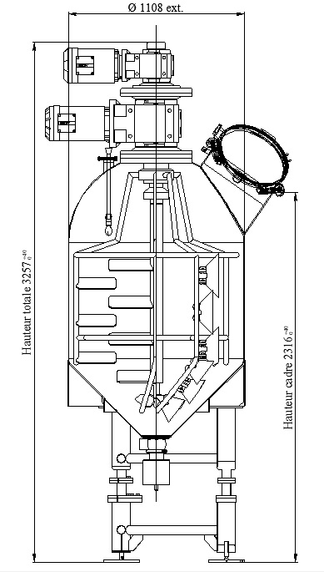
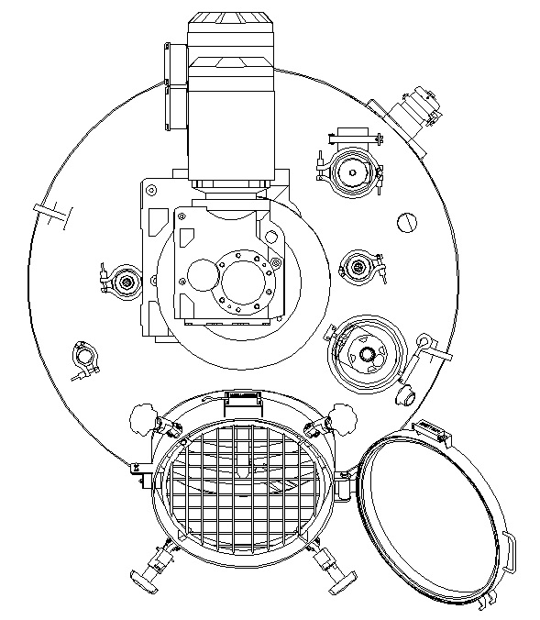
ail, sel, poivre, persil, ciboulette

Slide 21
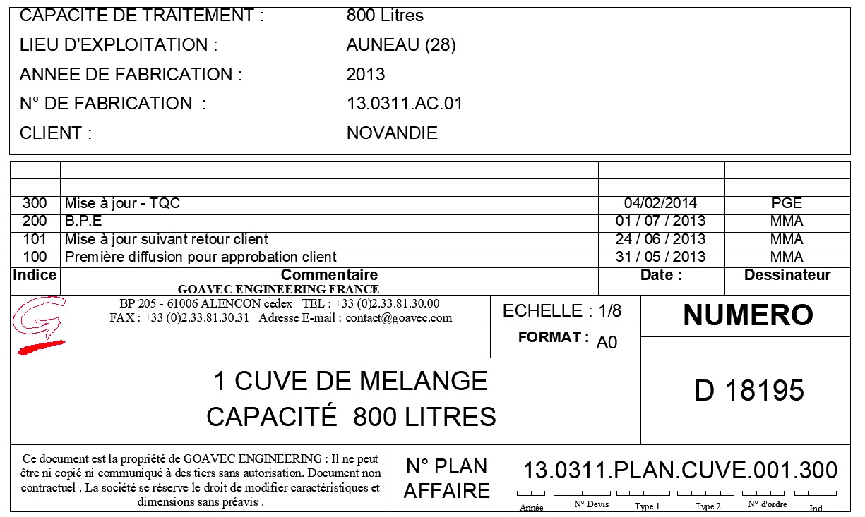
ail, sel, poivre, persil, ciboulette

